Slide 1
PhyloGENETIC SUPERTREE REVEALS DETAILED EVOLUTION OF SARS-COV-2
PRESENTATION BY: MARK NJAMA

Slide 2
Table of content
INTRODUCTION
METHODOLOGY
RESULTS INTERPRETATION
VALIDATION OF MRP SUPERTREE
MUTATION SITES
ADVANTAGES AND LIMITATIONS
CONCLUSION

Slide 3
Introduction
Notes:
What is the super tree method?

Slide 4
Introduction
What is the super tree method?
Combines a set of source trees to produce one comprehensive tree
Trees can be consistent or inconsistent or partly overlapping
Notes:
Supertree method, whose embryonic theory was described in the 1980s, combines a set of source phylogenetic trees to produce one comprehensive phylogenetic tree
Resonably named?

Slide 5
INTRODUCTION
At the time, the origin of SARS-Cov-2 and its evolutionary relationship was ambiguous.
Understanding the evolutionary history of SARS-Cov-2 using the super tree method
Discovery of evolutionary mutation in SARS-Cov-2
Origin of SARS-CoV-2?
Notes:
At the time, the origin of SARS-Cov-2 and its evolutionary relationship was ambiguous.
Several reports attempted to figure out this critical issue by genome-based phylogenetic analysis, yet limited progress was obtained, principally owing to the disability of these methods to reasonably integrate phylogenetic information from all genes of SARS-CoV-2.
Supertree method based on multiple trees can produce the overall reasonable phylogenetic tree.
Methods for phylogenetic tree construction are mostly based on a single gene in coronavirus genome or one artificial gene composed of the full-length genomic sequence
combines a set of source phylogenetic trees to produce one comprehensive phylogenetic tree
Furthermore, the discovery of evolution and mutation in SARS-CoV-2 was achieved by MRP pseudo-sequence supertree analysis. Taken together, the MRP pseudo-sequence supertree provided more information on the SARS-CoV-2 evolution inference relative to the normal phylogenetic tree based on full-length genomic sequences.
Ultimately can we find some clues of the origin of SARS-Cov-2?

Slide 6
METHODOLOGY

Slide 7
Dataset construction
Downloded full lenght genomic sequences and protein-coding sequences(CDSs) of:
102 SARS-CoV-2,
5 SARS-CoV,
2 MERS-CoV, and
11 bat coronaviruses
Notes:
The full-length genomic sequences and protein-coding sequences (CDSs) of 102 SARS-CoV-2, 5 SARS-CoV, 2 MERS-CoV, and 11 bat coronaviruses were downloaded from NCBI Severe acute respiratory syndrome coronavirus 2 data hub
Among genomic sequences of SARS-CoV and bat coronaviruses, those showing high similarity with genomic sequences of SARS-CoV-2 were chosen.

Slide 8
Dataset construction
High similarity sequences were selected
Sequence integrety was checked
Fragmented sequences were reconstructed
Notes:
Among genomic sequences of SARS-CoV and bat coronaviruses, those showing high similarity with genomic sequences of SARS-CoV-2 were chosen.
The integrity of sequences was checked, and the fragmented sequences were reconstructed.

Slide 9
Construction of phylogenetic tree with full-length genomic sequences
Aligned using the L-INS-i method of MAFFT
Aligned sequences were converted into phylip file format by Clustal W
Maximum likelihood (ML) trees were constructed
Resampling with a bootstrap value of 100
Figtree for visualization
Notes:
L-INS-i can align a set of sequences containing sequences flanking around one aligned domain. In this method Flanking sequences are ignored in the pairwise alignment by the Smith-Waterman algorithm
Maximum likelihood (ML) trees based on full-length genomic sequences were constructed and estimated by PhyML with 100 bootstraps resampling. The phylogenetic trees were visualized by FigTree

Slide 10
ML tree using full-length genomic sequences
To the right is the ML(maximum likelihood) based off the full genomic sequences
With MERS-CoV as the outgroup
The tree has very low clade resolution
Notes:
We shall see what this means in a bit

Slide 11
Construction of phylogenetic supertrees
Built a MRP-pseudo-sequence supertree
CDSs for orthologous proteins were organized using the OrthoMCL program
repeated sequences removed from the orthologous groups
The CDSs were assigned to their corresponding orthologous protein groups
aligned by MAFFT with the L-INS-i method.
Notes:
The matrix representation with parsimony (MRP). pseudo-sequence supertree was built in this study.
Firstly, ten groups of CDSs for orthologous proteins in selected coronaviruses were organized using the OrthoMCL program

Slide 12
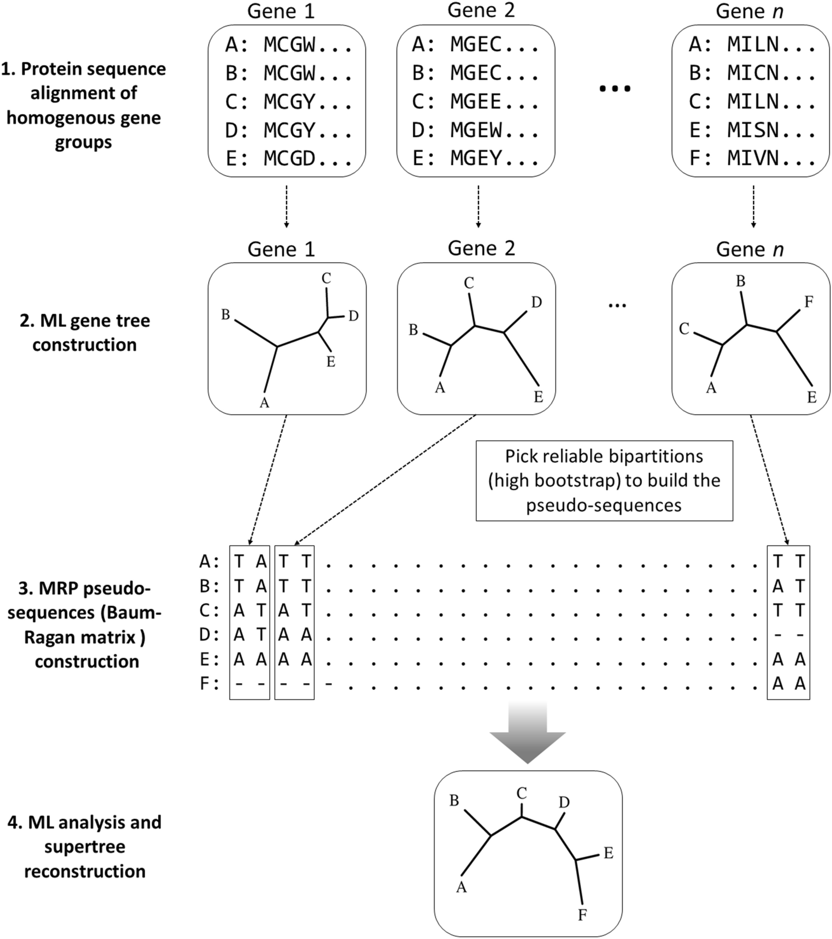
MRP pseudo-sequence supertree method
Protein sequence alignment of homogenous gene groups
ML gene treee constructions
MRP psudo sequence construction
ML analysis and supertree reconstructions
In addition, Clann software was also used to construct traditional MRP supertree
Notes:
The construction steps of MRP pseudo-sequence supertree is briefly illustrated to the right
Firstly, ten groups of CDSs for orthologous proteins in selected coronaviruses were organized using the OrthoMCL program
repeated sequences were removed from the orthologous groups.
The CDSs of 120 coronaviruses were assigned to their corresponding orthologous protein groups
alignment by MAFFT with the L-INS-i method, followed with formation into phylip file by Clustal W
Secondly, ML phylogenies by using PhyML were employed to build source phylogenetic trees based on each CDSs, with 100 bootstrap replications
Thirdly, the members of each clade making up the selected bipartitions (above 55% bootstrap support) are assigned an A or T, and custom-made scripts were applied to retrieve the Baum-Ragan matrix pseudo-sequences
Fourthly, The pseudo-sequences of the coronaviruses were used to re-construct the phylogenetic supertree using PhyM
In addition, published supertree software Clann was also used to construct traditional MRP supertree

Slide 13
results

Slide 14
results
Divergent locations of viruses were consistent with that from ML tree
MRP pseudo-sequence supertree analysis showed more resolution power than ML tree
supertree successfully identified civet-sampled coronavirus AY572035 to be the closest ancestor of the SARS-CoV
Notes:
In the MRP pseudo-sequence supertree SARS-CoV and MERS-CoV were placed on one major branch,
while SARS-CoV-2 belonged to another major branch.
The divergent location of SARS-CoV-2 relative to SARS-CoV and MERS-CoV on the MRP pseudo-sequence supertree were consistent with the results from the phylogenetic ML tree in this study
However, some discrepancies present between the MRP pseudo-sequence supertree and the ML tree. In particular, the MRP pseudo-sequence supertree analysis showed more resolution power than ML tree approach. Distinctive phylogenetic distances on clades of SARS-CoV and SARS-CoV-2 in MRP pseudo-sequence supertree, explicitly presented evolutionary relationships among coronaviruses.
Also, the MRP pseudo-sequence supertree successfully identified civet-sampled coronavirus AY572035 to be the closest ancestor of the SARS-CoVs

Slide 15
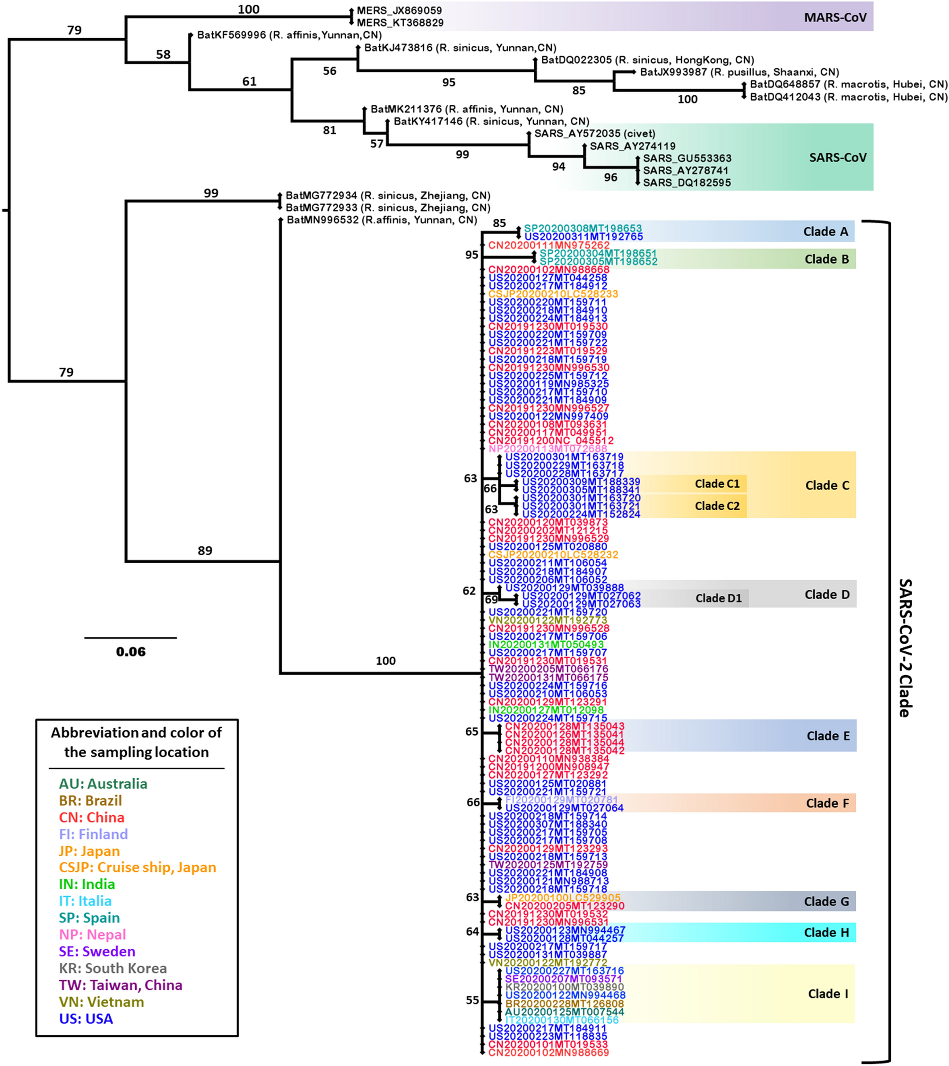
results
the super tree reveals:
Civet cov is the closets ancestor of SARS-cov
Divergent locations of viruses were consistent
Clear evolutionary history of SARS-CoV-2
The reliability guaranteed by high bootstrap values between 55 and 95.
Notes:
Also, the MRP pseudo-sequence supertree successfully identified civet-sampled coronavirus AY572035 to be the closest ancestor of the SARS-CoVs, which was highly consistent with the previous study
The divergent location of SARS-CoV-2 relative to SARS-CoV and MERS-CoV on the MRP pseudo-sequence supertree were consistent with the results from the phylogenetic ML tree in this study
What is more, the MRP pseudo-sequence supertree showed detailed evolutionary relationship of SARS-CoV-2, with nine sub-branches identified from Clade A to Clade I
The reliability of phylogenetic inference of SARS-CoV-2 in supertree is sufficiently guaranteed by high bootstrap values between 55 and 95

Slide 16
ML tree vs supertree
Notes:
Just to reiterate the super tree reveals:
Civet cov is the closets ancestor of SARS-cov
Divergent locations of viruses were consistent
Clear evolutionary history of SARS-CoV-2
The reliability guaranteed by high bootstrap values between 55 and 95.

Slide 17
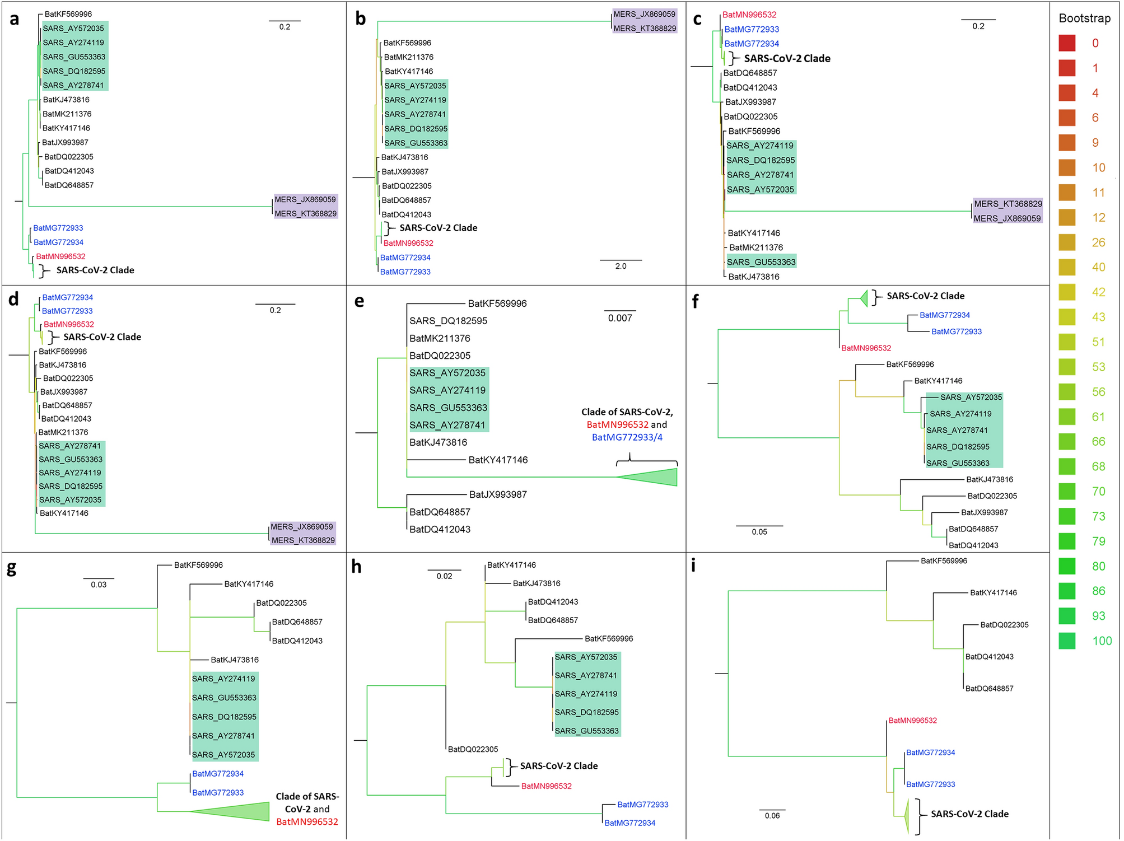
Source phylogenetic ML trees
Figure a contains ORF1ab
Figure b contains spike protein genes
Figure c contains the genes for m protein
Figure d contains the genes from N protein
F- orf3a
G- orf6
H- orf7a
i- orf8a
Notes:
The major factor that determines the topology of the phylogenetic ML tree appears to be the ORF1ab gene that is about 75% of the genome. this is readily explained by the fact that evolutionary relationship was similar in the phylogenetic ML tree relative to the source phylogenetic ML tree based on the sequence of ORF1ab gene
Clades of SARS-CoV-2 are in bold in all source phylogenetic ML trees. Bat virus MG996532 is written in red, MG772933 and MG772934 are in blue. Clades of SARS-CoV and MERS-CoV are highlighted in green and purple, respectively.

Slide 18
Validation of MRP supertree

Slide 19
VALIDATION OF mrp supertree
ALF simulation to compare full-length genomic tree and MRP supertree
In addition, Clann software was also used to construct traditional MRP supertree
Notes:
To prove MRP pseudo-sequence supertree is more preferable for analysis of coronavirus phylogenetics, they used ALF simulation frame to compare MRP supertree with full-length genomic sequence ML tree.
In addition, Clann software was also used to construct traditional MRP supertree

Slide 20
Aritificial life framwork
Figure a. Is the real tree generated by ALF
Figure b. Is the ML full-length genomic sequence tree
Figure c the is the MRPpsudo-sequence supertree
Figure d is the MRP supertree constructed using clann(v4.24)
Inconsistent node and taxa have been pointed out with a red arrow and square respectively.
Notes:
Here we have a Simulation evolution to evaluate the accuracy/uncertainty of MRP supertree and ML tree.
the real tree generated by Artificial Life Framework;
the ML full-length genomic sequence ML tree; c
the MRP pseudo-sequences supertree;
the MRP supertree constructed by Clann.
Of particular interest was that the taxon SE008 was placed on an inappropriate position—an inconsistent node in the ML tree
The inconsistent node and taxa were indicated by the red arrow and red frame respectively.

Slide 21
MUTATION SITES

Slide 22
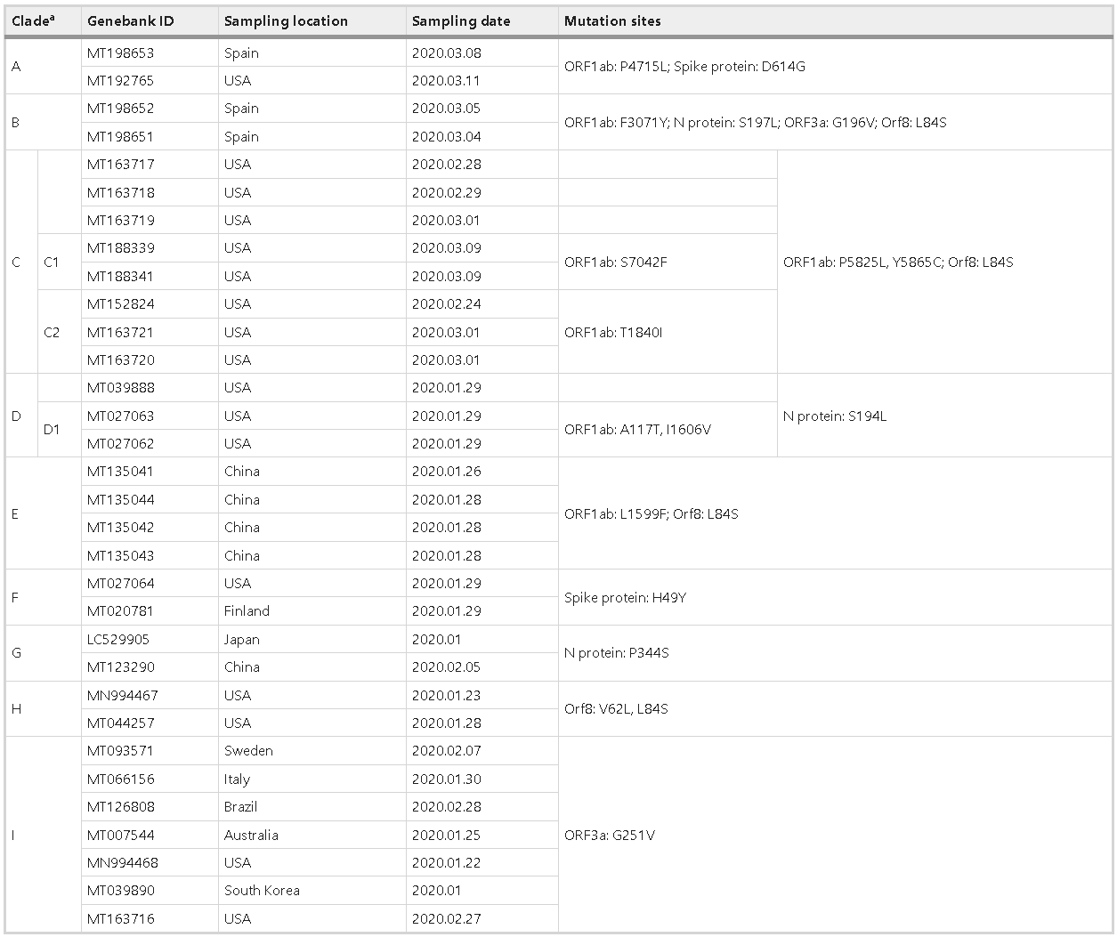
Mutation sites
Nine clades identified
displayed an evolutionary scenario of the SARS-CoV-2s in human hosts over time
Mutations within 5 viral proteins are seen
Notes:
Within phylogenetic MRP pseudo-sequence supertree, nine sub-branches were resolved in SARS-CoV-2 clades, labeled from clade A until clade I
which were absent in phylogenetic ML tree based on full-length genomic sequence analysis
The sub-branches displayed an evolutionary scenario of the SARS-CoV-2s in human hosts
By interrogating ten CDSs of SARS-CoV-2s, diverse mutations are seen within five viral proteins, which are ORF1ab, N protein, spike protein, ORF3a, and ORF8

Slide 23
Mutation sites...
SARS-CoV-2s from the USA displayed common mutation in clades of A, C, D, F, H, and I,
Detection of identical mutations in ORF3a protein (G251v) in clade I
Notes:
Most strikingly, SARS-CoV-2s from the USA displayed common mutation in clades of A, C, D, F, H, and I,
Another important finding was detection of the identical mutation in ORF3a protein (G251V) in clade I
This indicated the spread of the G251V mutant happened earlier on in the outbreak , in Sweden, Italy, Brazil, Australia, and the USA.

Slide 24
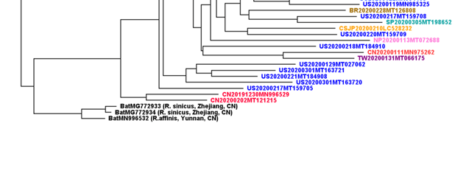
Clues to the origin of SARS-COV-2
MRP pseudo-sequence supertree and ML tree exhibited, RaTG13 (MN996532), bat-SL-CoVZC45 (MG772933), bat-SL-CoVZXC21 (MG772934) and SARS-CoV-2s formed one major clade
phylogenetic distance of SARS-CoV-2s and RaTG13 was distinctly exhibited in the MRP pseudo-sequence supertree
Notes:
As the phylogenetic MRP pseudo-sequence supertree and ML tree exhibited, RaTG13 (MN996532), bat-SL-CoVZC45 (MG772933), bat-SL-CoVZXC21 (MG772934) and SARS-CoV-2s formed one major clade
In particular, RaTG13 isolated from a bat in China, is the closest relative of SARS-CoV-2s, which substantiates the previously reported phylogeny of SARS-CoV-2s constructed with the whole genome.
However, the phylogenetic distance of SARS-CoV-2s and RaTG13 was distinctly exhibited in the MRP pseudo-sequence supertree

Slide 25
ADVANTAGES AND LIMITATIONS

Slide 26
ADVANTAGES AND LIMITATIONS
ADVANTAGES
LIMITATIONS
Higher clade resolution.
combine data in various forms, to produce the overall finest supertree.
Widely used for datasets with large genome sizes.
loss of information caused by using the source trees to re-construct.
Only recently used for organisms with small genome sizes.
Notes:
combine data in various forms, including DNA or amino acid sequences, morphology, immunological distances, etc., to produce the overall finest supertree.
loss of information caused by using the source trees to re-construct supertree is inevitable
yet simulation studies proved that this trade-off is an affordable cost to be able to integrate all possible sources of phylogenetic information

Slide 27
CONCLUSION
Notes:
What did this paper manage to achieve ?

Slide 28
CONCLUSION
The supertree method is a powerful approach
Higher resolution for phylogenetic analysis
distance in clades can only be detected by MRP pseudo-sequence supertree.
Study revealed various common mutations in SARS-CoV-2
Rationally evaluated RaTG13 to be the last common ancestor of SARS-CoV-2s,
Notes:
Compared with other phylogenetic analysis methods, the supertree method showed more resolution power for phylogenetic analysis of coronaviruses
In particular, the MRP pseudo-sequence supertree analysis firmly disputes bat coronavirus RaTG13 be the last common ancestor of SARS-CoV-2, which was implied by other phylogenetic tree analysis based on viral genome sequences

Slide 29
Thank you
Notes:
Any questions?

